Slide 1



Dig That Lick Digital Jazz Research
Klaus Frieler
Institut für Musikwissenschaft, Weimar-Jena
From No Time to Ragtime
JLU Gießen
6. Mai 2019

Slide 2
Agenda
Part I: Presentation
Computational Musicology: What, why, how?
The Jazzomat Research Project and the Weimar Jazz Database
Assorted Examples
Ideational Flow Model
Midlevel analysis (MLA)
Patterns
Conclusion & Outlook
Part II: Question & Answers
Part III: Exercises for everyone
Part IV: General discussion

Slide 3
Computational Musicology

Slide 4
Computational Musicology
Complements and enhances existings and provides new analysis methods.
Pioneered by corpus-based sub-fields (e.g., ethnomusicology, old music research).
Recent boost by Music Information Retrieval since the early 2000s and by pervasion of computers and the internet („Music Google“).
Very active research field.
Connections to many different subfields of musicology
Computational ≠ digital musicology!

Slide 5
Computational Musicology
Advantages:
Facilitates collection and curation of big data sets (improved reliability).
Necessary to analyse musical big data set.
Acceleration of research processes.
Development and test of models.
Enables analysis pathways that are otherwise hard to obtain (e.g., timbre, intensity, intonation).

Slide 6
Computational Musicology
Issues:
Focus on quantitative methods.
Often a simplification and detailed definition of concepts is needed to suit them for computer-use (can also be an advantage!).
High entry threshold (extra knowledge in maths, computer science, stats, machine learning, signal procession required).
„Proving the obvious“ (but: „hindsight bias“).

Slide 7
Computational Musicology
Transcriptions
Audio
Metadata
Score
Sound Analysis
Music Analysis
Statistics
Results

Slide 8
Jazzomat Research Project & Weimar Jazz Database

Slide 9
The Jazzomat Research Project
Compiling the Weimar Jazz Database with 456 high-quality monophonic jazz solo transcriptions.
Developing analysis tools (MeloSpySuite, MeloSpyGUI):
Feature extraction, visualization
Pattern search and paatern mining.
Data import/-export
Research focus:
Jazz research, jazz history, stylometrics.
Psychology musical creative processes.
Music informatics, statistical music analysis, MIR.
Jazz pedagogy, jazz theory, didactics of improvisation.
DFG-Forschungsprojekt (12/2012 bis 4/2017)
Melodisch-rhythmische Gestaltung von Jazzimprovisationen. Rechnerbasierte Musikanalyse einstimmiger Jazzsoli

Slide 10
Studies
Style classification post-bop vs. bebop/hard bop
Solo dramaturgy
Microtiming & swing
Sound analysis (Loudness/accents, vibrato, intonation etc.)
Case studies (e.g., So What, Bob Berg‘s solo on Angles, style comparison Trane ./. Miles)
Feature history of jazz improvisation
“Weimar Bebop Alphabet”
Ideational flow model/mid-level analyse
Perception of virtuosity, musicality, and emotions in jazz
Walking bass
Patterns in jazz (WJD, Charlie Parker)
Automatic solo generation
https://jazzomat.hfm-weimar.de/publications.html

Slide 11
Transcriptions
Performance-oriented approach.
Annotated sequences of tone events described by onset, pitch, duration.
Annotations:
Metadata (manual),
Harmonic context (manual),
Metrical context (semi-automatic),
phrases/MLUs (manual),
F0 modulations (manual),
Intensities (automatic).

Slide 12
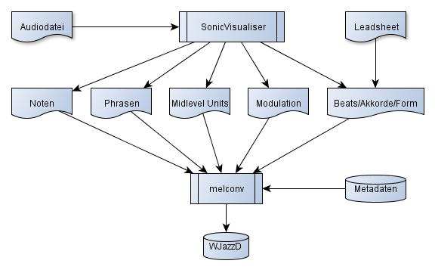
Transcriptions: Practice

Slide 13
Klanggestaltung/Sound
Wichtige expressive Mittel:
Frequenzmodulationen,
Intensität/Lautheit,
Intonation.
Manuelle Annotation von Modulationen durch die Transkripteure (Vibrato, Bend, Fall-off, Slide).
Lautheit ist nicht manuell zu annotieren.
Dito: Intonation.
Lösung: Automatisierung.

Slide 14
Acoustical Annotations
Sound and timbre hard to describe and to measure wioth traditional methods.
Transcriptions informed automatic main melody extraction.
f₀ tracking, intonation and intensity measurement on extracted solo.
f₀ curves: vibrato frequency, vibrato amplitude, f₀ gradient etc.

Slide 15
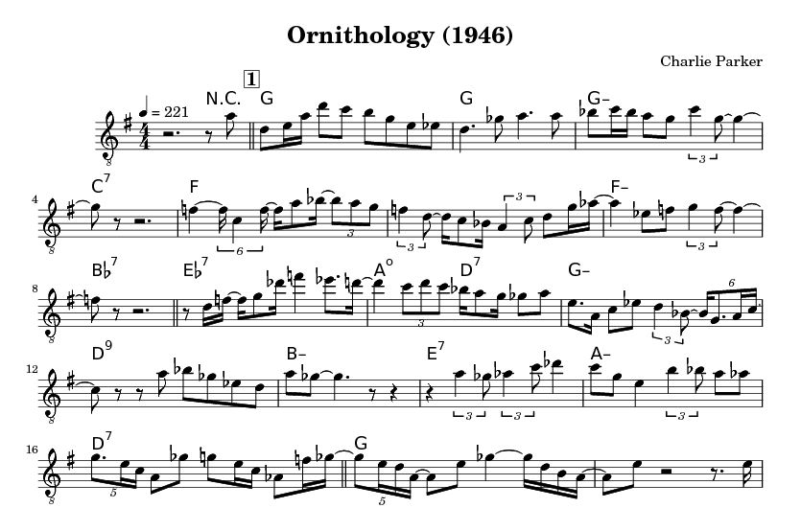



Jazz Karaoke with Charlie
Charlie Parker
Ornithology 1946

Slide 16
Weimar Jazz Database (WJD)
456 solos by 78 different performers.
200.809 tone events.
Top performer: Coltrane (20), Davis (19), Parker (17), Rollins (13), Liebman (11), Brecker (10), Shorter (10), S. Coleman (10).
Styles: traditional (32), swing (66), bebop (56), cool (54), hard bop (76), post-bop (147), free (5 = Ornette Coleman).
Instruments: ts (158), tp (101), as (80), tb (26), ss (23), other (68).
Time range: 1925 – 2009
Focus on the jazz canon, nearly exclusively US-American musicians.

Slide 17
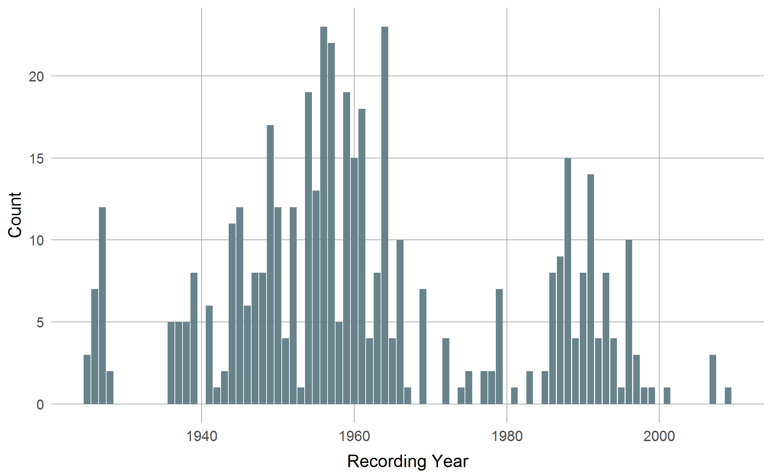
Distribution by Time
Golden Era
Bigband Gap
Fusion Gap

Slide 18
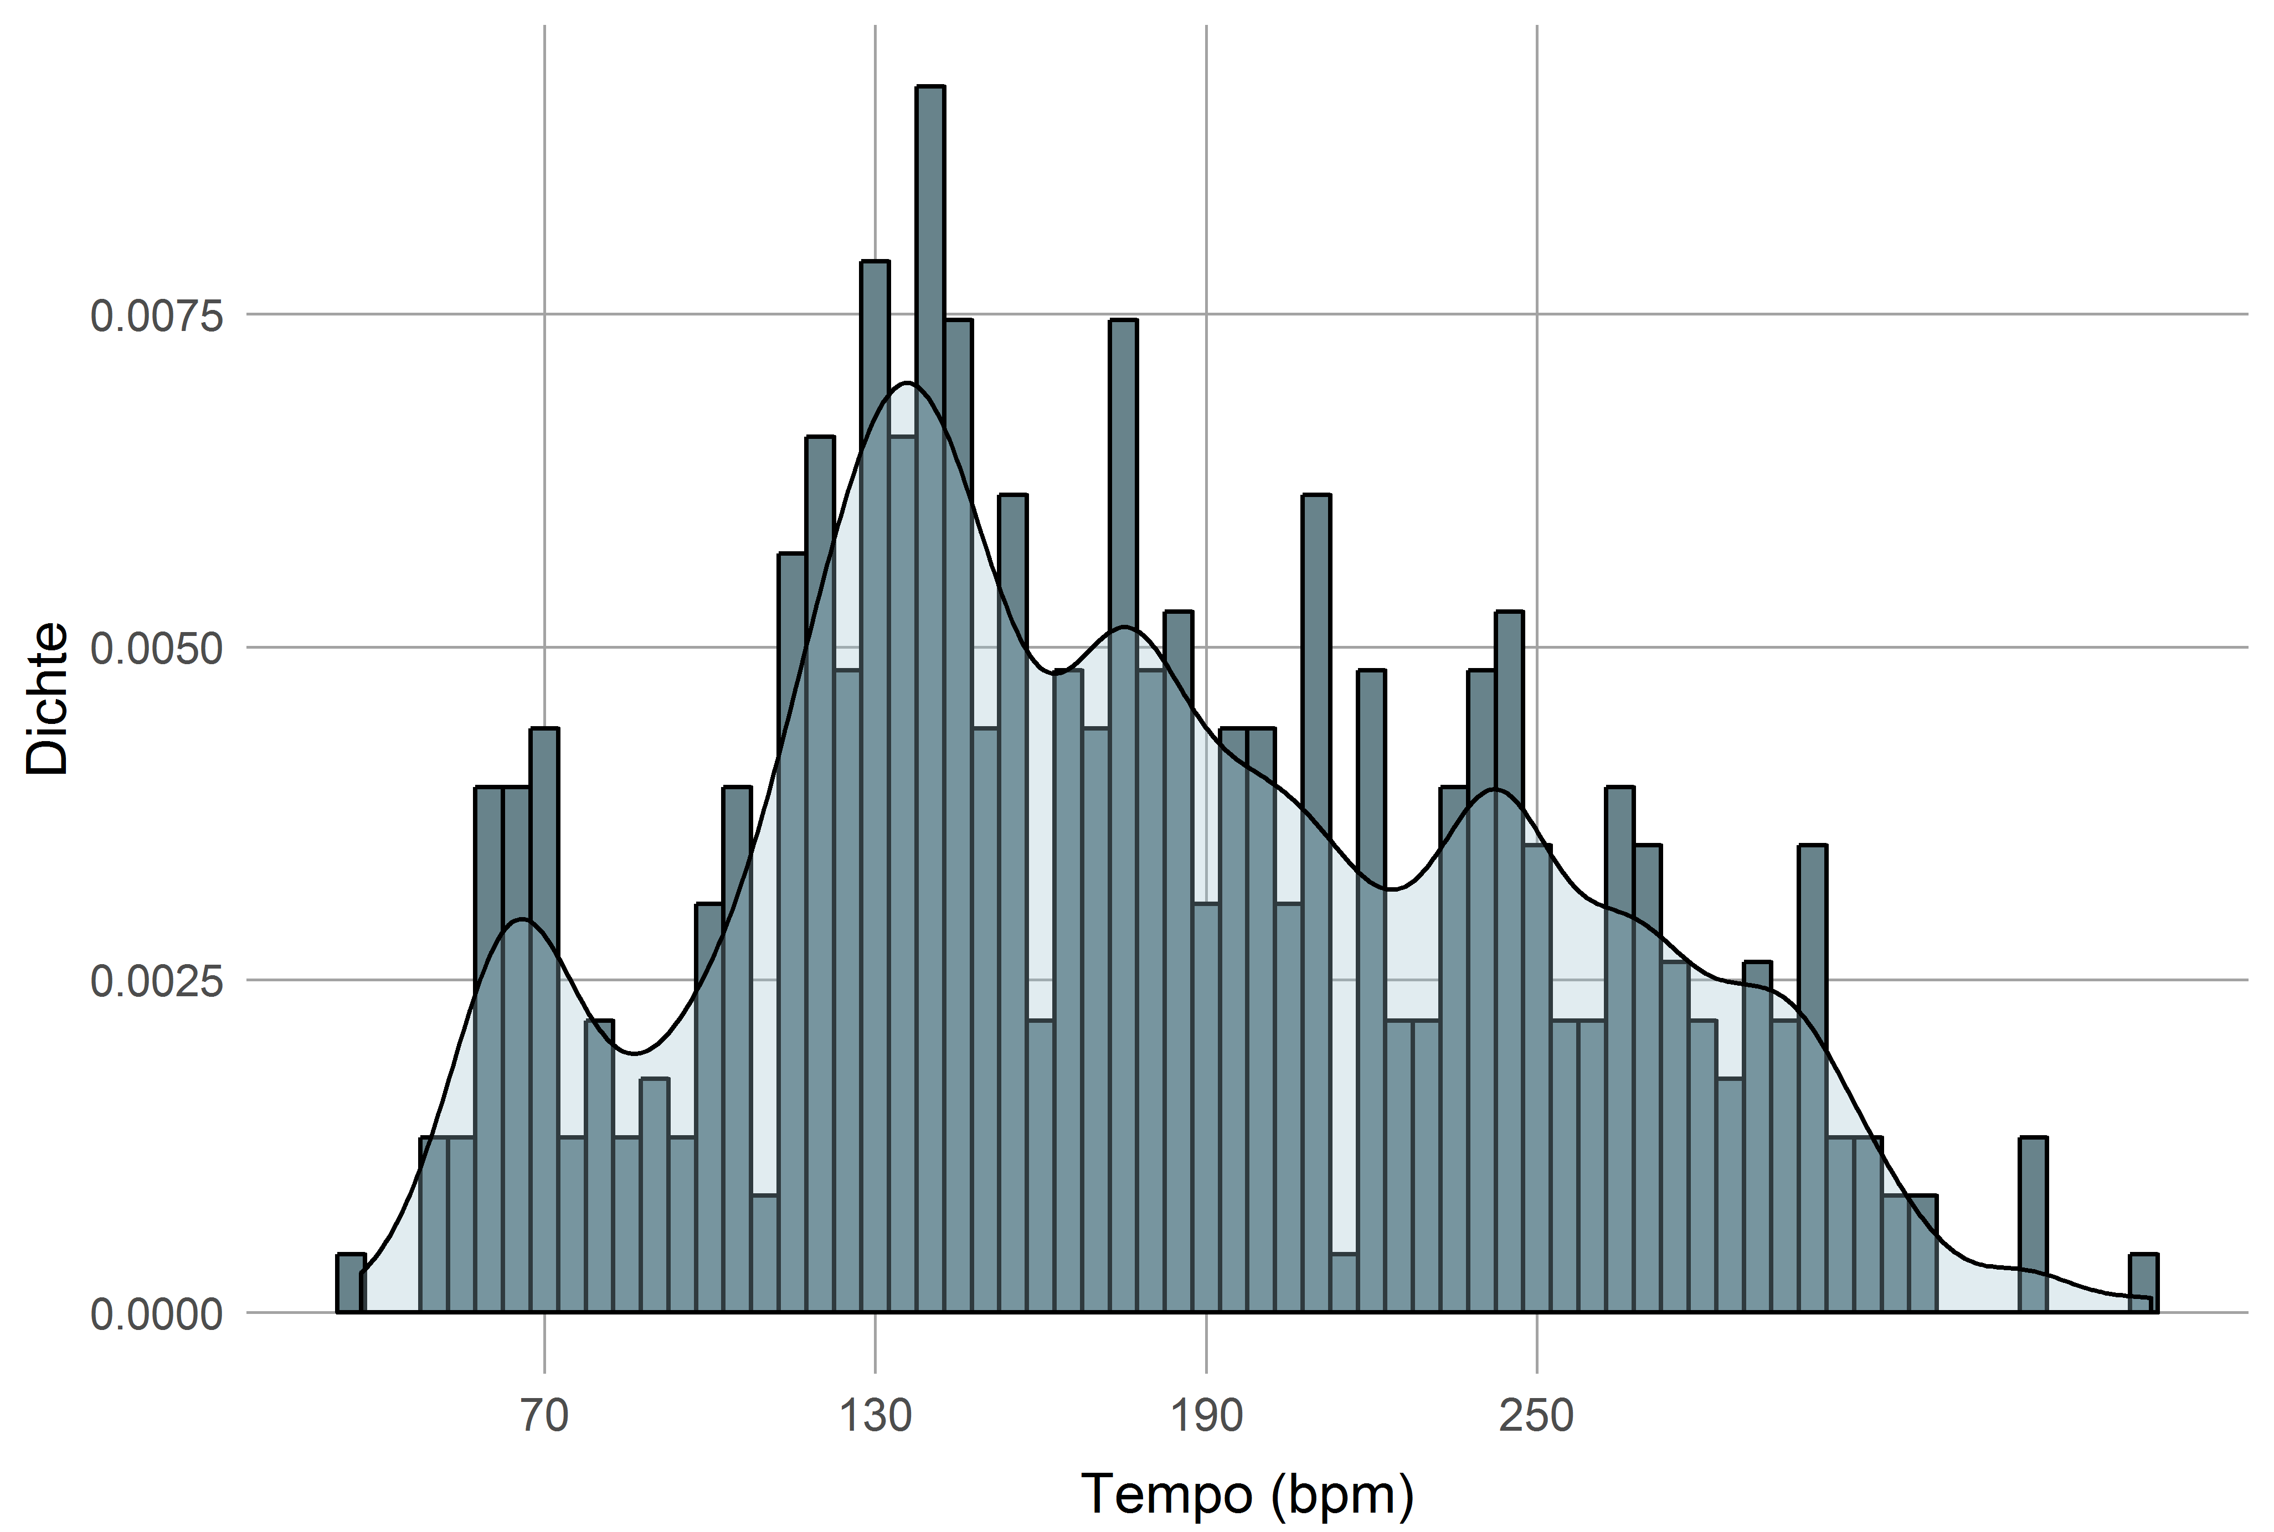
Tempo Distribution

Slide 19
Assorted Examples

Slide 20
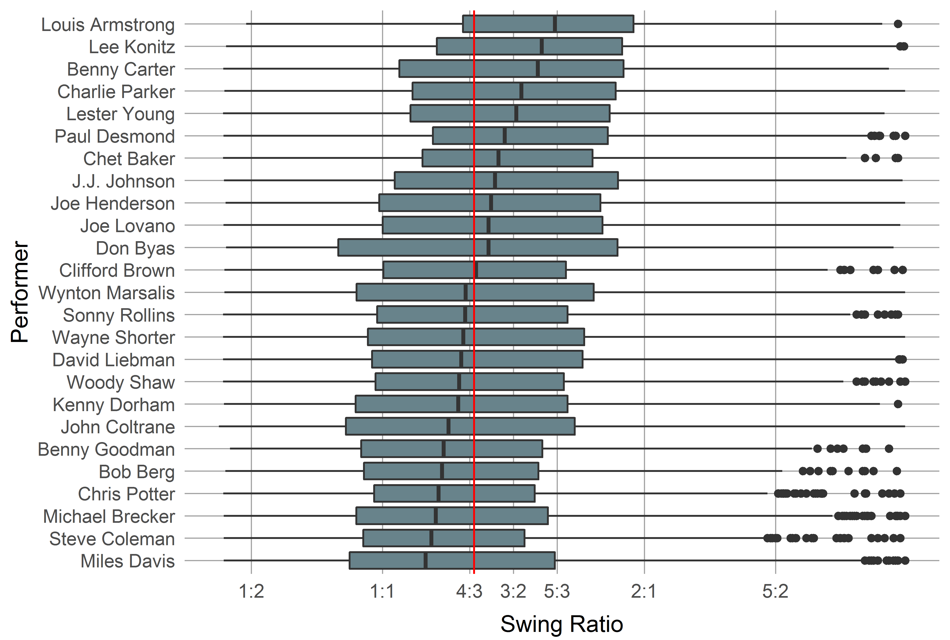
Example: Swing Ratio
Average swing ratio (long:short) is 4:3.

Slide 21
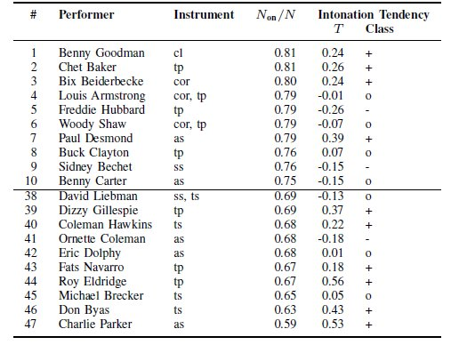
Example: Intonation
Average: N_{on}/N = .72

Slide 22
Excursion: Features
Features are numerical or categorial properties here of melodies.
Mostly based on some transformation of the melodical surface.
External metadata also considered features.
Possibility space for feature is virtually infinite (modular construction system: „feature machine“).
Currently, over 600 pre-defined features in the MeloSpyGUI.

Slide 23
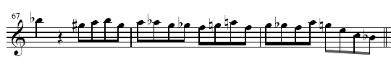

Excursion: Transformations
Excerpt from Bob Berg’s solo on „Angles“
pc: 10 8 9 10 8 9 8 7 6 5 6 9 5 7 6 5 9 7 4 0 10
cpc : 7 5 6 7 5 6 5 4 3 2 4 6 2 4 3 2 6 4 1 9 7
cdpc: 5 4 T 5 4 T 4 3 B 2 3 T 2 3 B 2 T 3 2 6 5
int: -2 1 1 -2 1 -1 -1 -1 -1 2 2 -4 2 -1 -1 4 -2 -3 -4-2

Slide 24
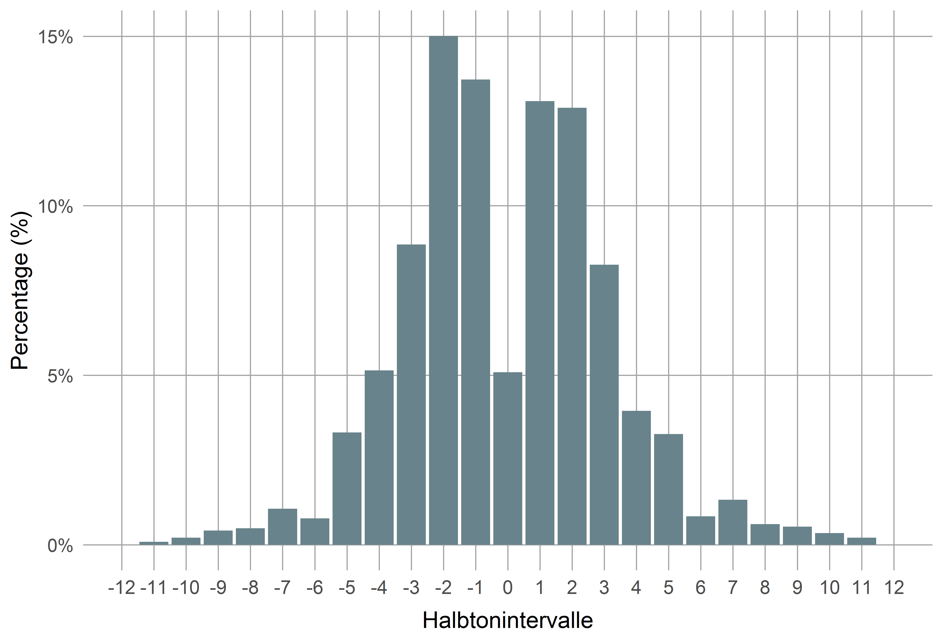
Example: Interval Distribution

Slide 25
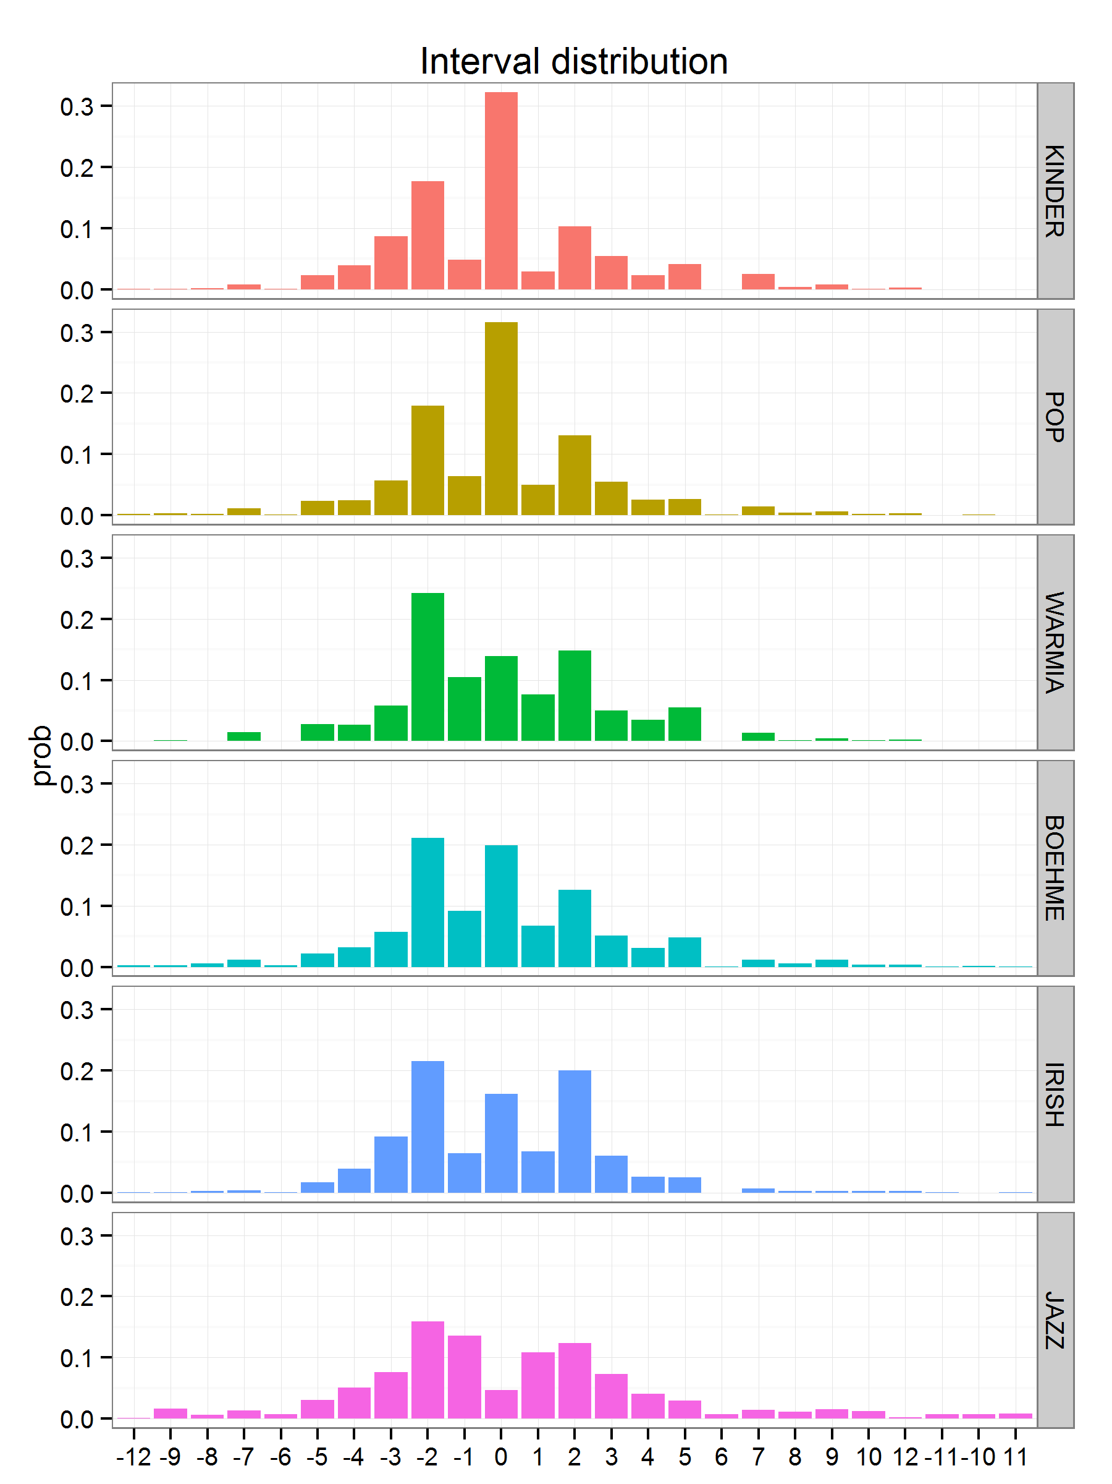
intervallverteilung

Slide 26
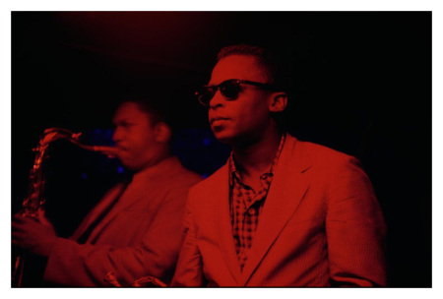
Example: Miles vs. Trane
 | John Coltrane | Miles Davis
Rhythm | Mostly fast lines („Sheets of sound“) | Rhythmically more diverse
 |  | Longer tones & pauses
Intervals | More descending | More ascending
 | Less tone repetitions | More tone repetitions
 | Larger intervals | Smaller intervals
 | More thirds & arpeggios | Less thirds
Pitch | Larger pitch range | Smaller pitch range
 |  | Avoids thirds, more blue notes
Midlevel Units | More lines, expressive & fragments | More licks, melody & void
Patterns | More patterns | Less patterns
 | No common pattern vocabulary

Slide 27
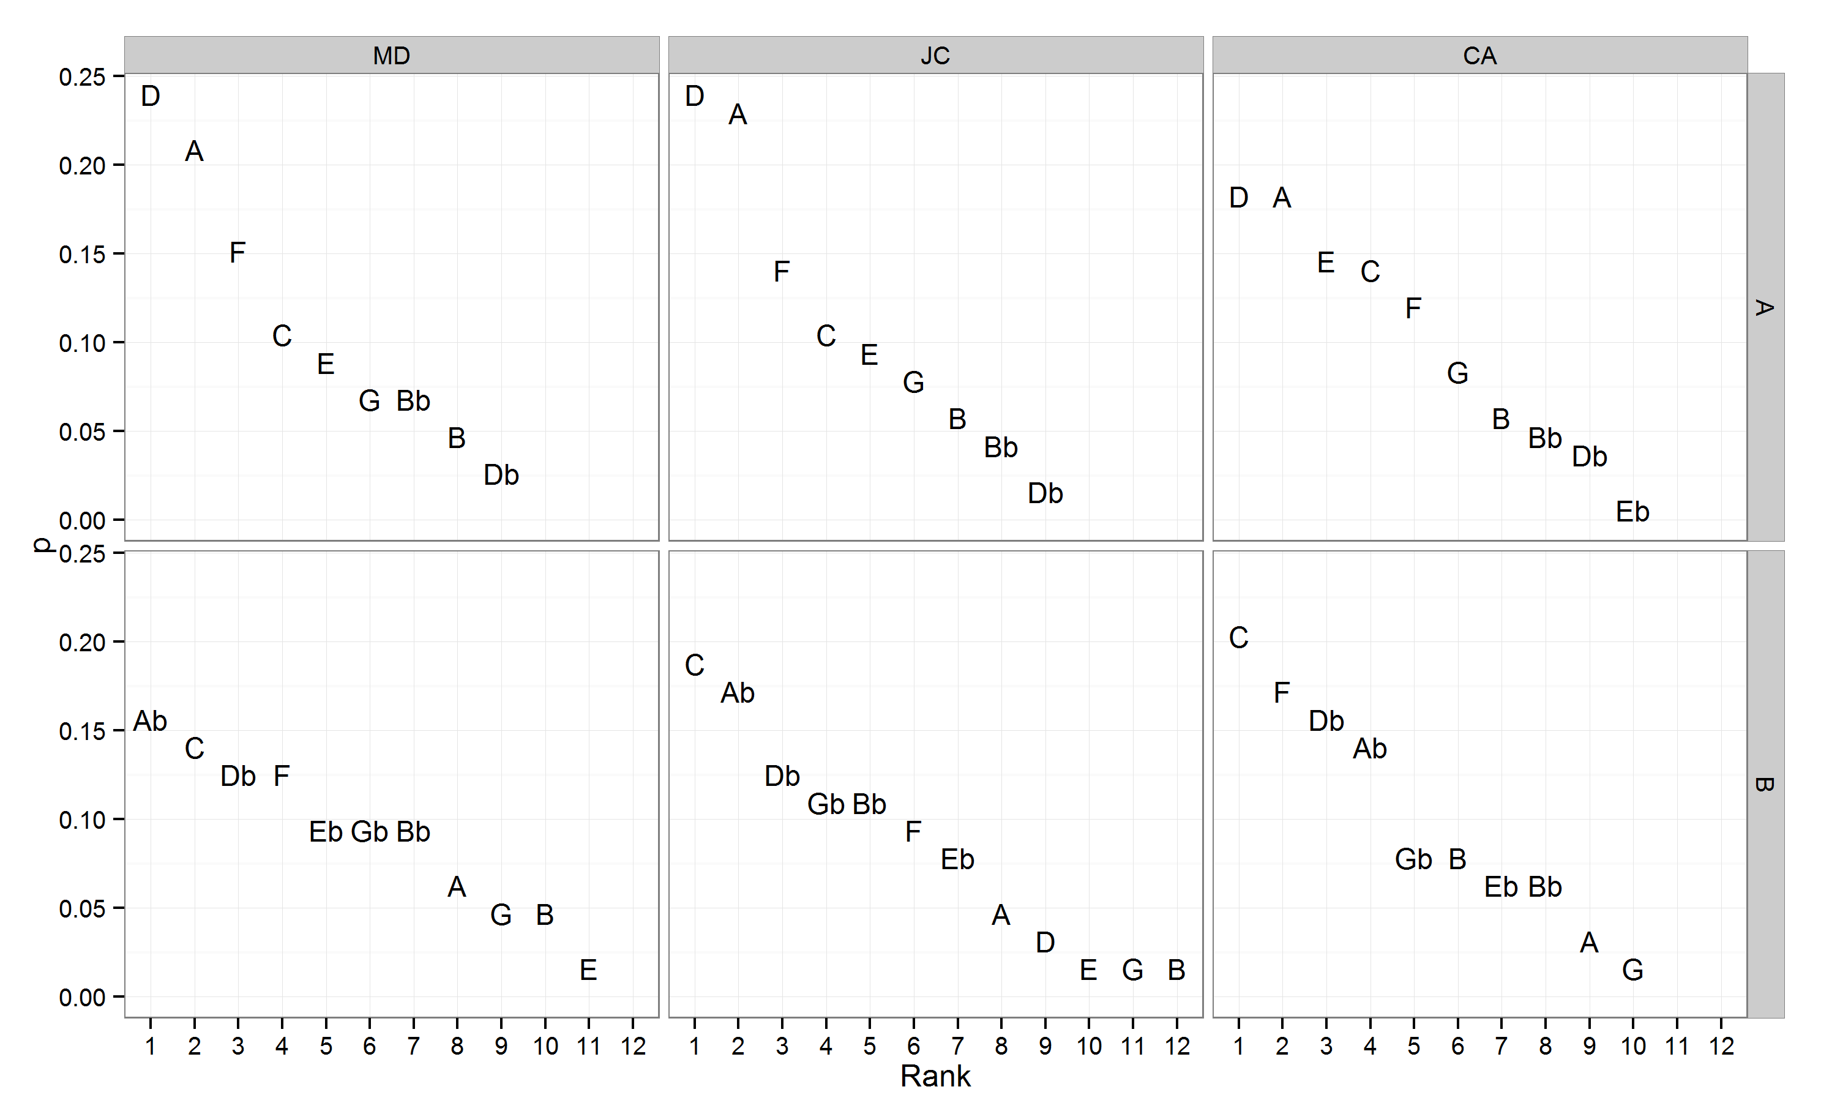
Example: So What (pc, bass)
D dorian
Eb dorian?

Slide 28
Ideational Flow Model

Slide 29
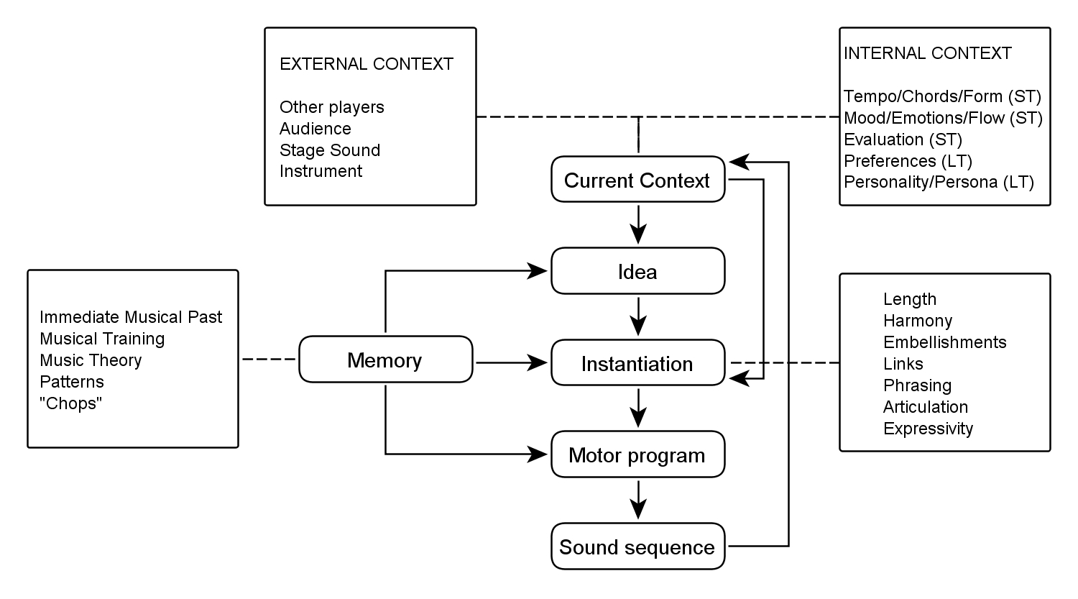
Ideenflussmodell

Slide 30
Midlevel Analysis
Aim: To phenomenologically describe the underlying „ideas“ of improvisers on a midlevel.
Qualitative method, inspired by content analysis and Grounded Theory.
Category system for midlevel units (MLU) extracted from the data (open and axial coding).
Manual annotation by transcribers.

Slide 31
Midlevel Analysis
Continuous and gap-less annotation of the musical event stream with midlevel units (MLUs, „ideas“).
No overlap between MLUS.
Hierarchical category system:
9 main types (line, lick, rhythm, expressive, theme, quote, fragment, void)
18 subtypes,
39 sub-subtypes.
Annotation of motivical relationships between MLUs.

Slide 32
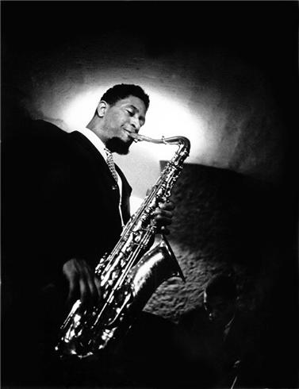
MLA: Example Sonny Rollins: Blue Seven

Slide 33
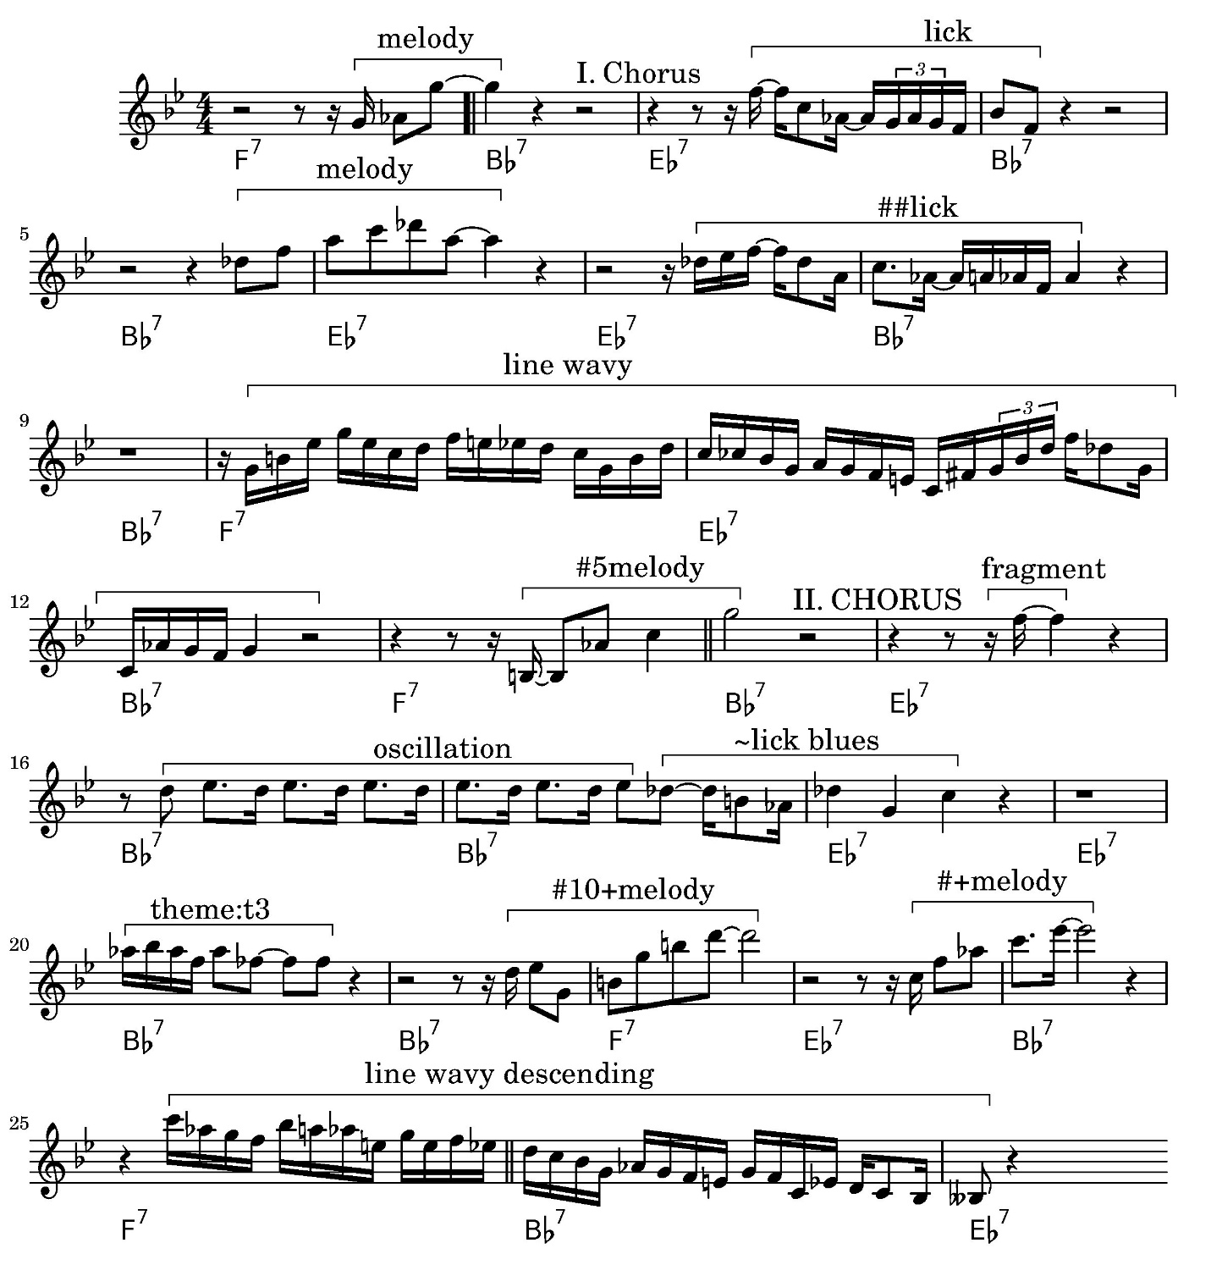


Slide 34
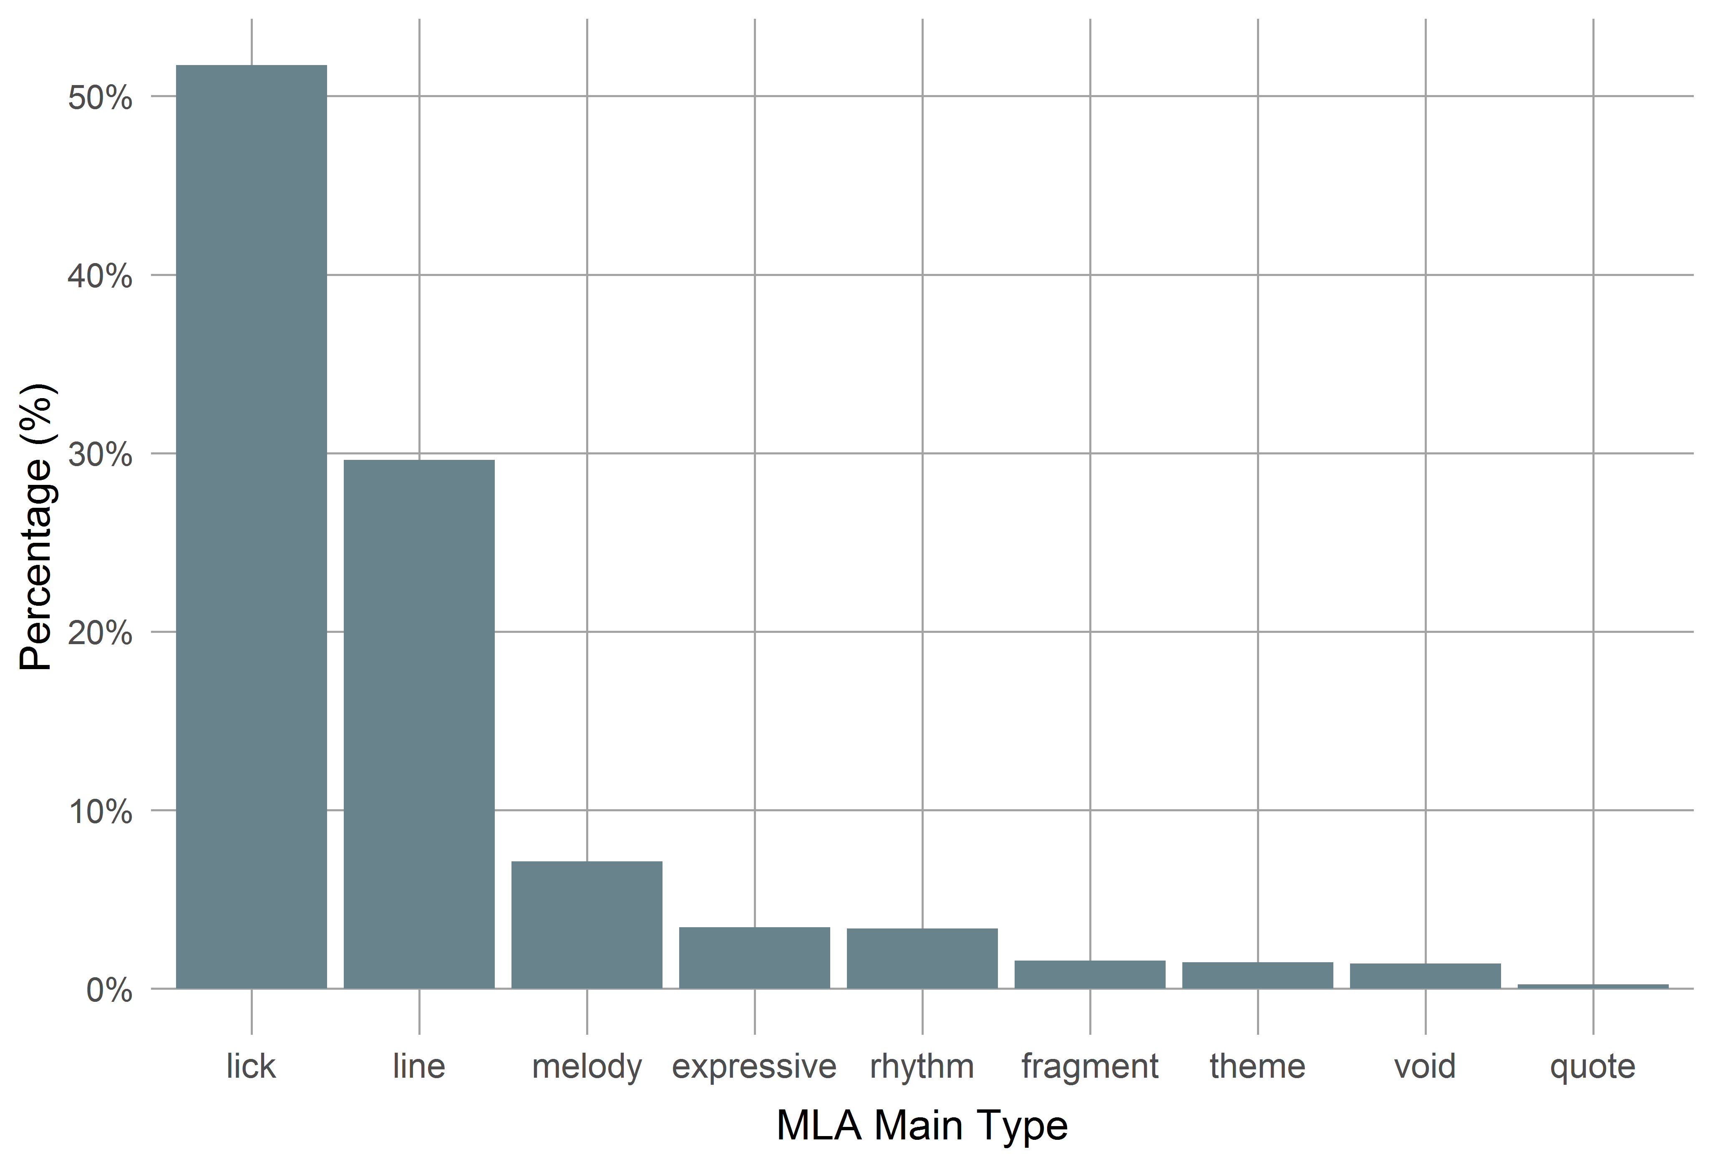
MLU: Distribution
Percentage of derived MLUs:
M = 25.1%
Average duation: 2.3 s / 2.2 measures

Slide 35
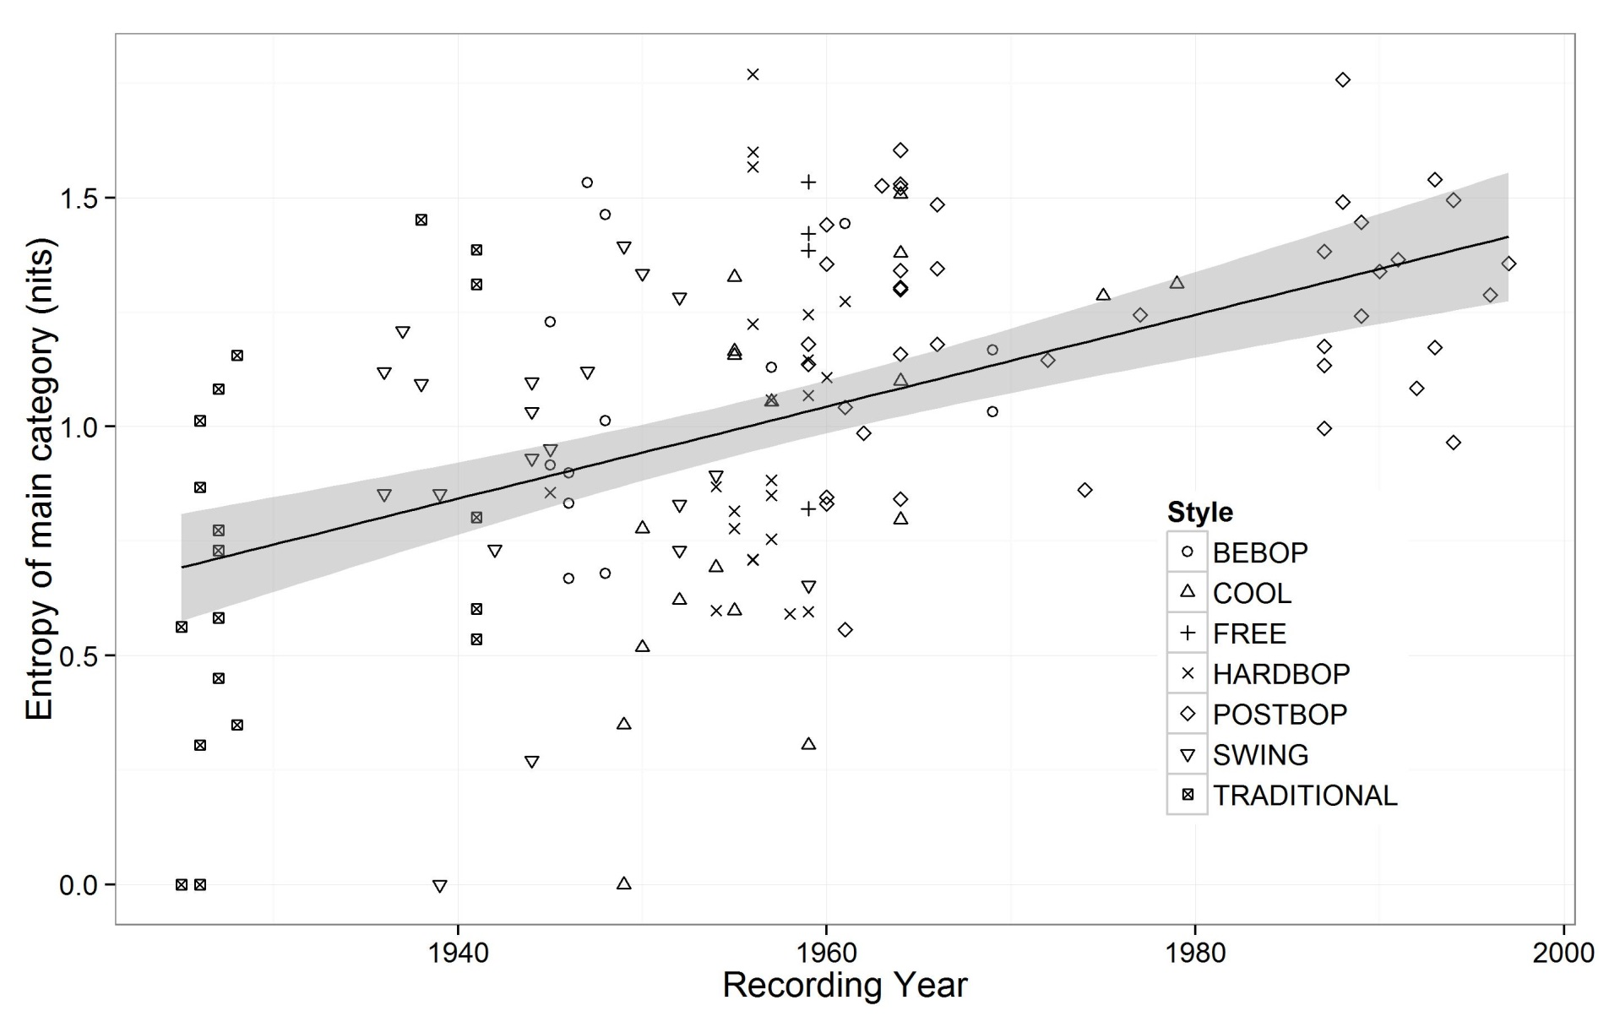
MLA: MLU Multitude

Slide 36
Patterns in Jazz
Using licks and formulas (patterns) important for jazz improvisation.
How can patterns as basic buildings blocks be shown?
Which share of a solo is based on patterns?
Can (oral) transmission of patterns by proved?
Investigation of exact, realised patterns.
Patterns are N-Grams in a set of sequences, with certain conditions (frequencies).
Basic sequences are transformations of tone events (mostly intervals and pitches)

Slide 37
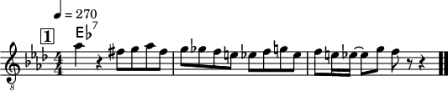

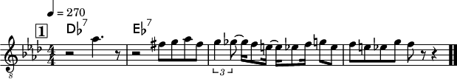
Patterns: Example
18-tone int pattern by Bob Berg on „Angles“.
[-2, 1, 1, -2, 1, -1, -1, -1, -1, 2, 2, -4, 2, -1, -1, 4, -2]
17-tone int pattern by Charlie Parker on „Scrapple from the Apple“ und „Billies Bounce“.
[-1, -2, -2, -2, -1, -2, -2, -1, 3, 3, 3, 2, -3, -2, 2, -3]

Slide 38
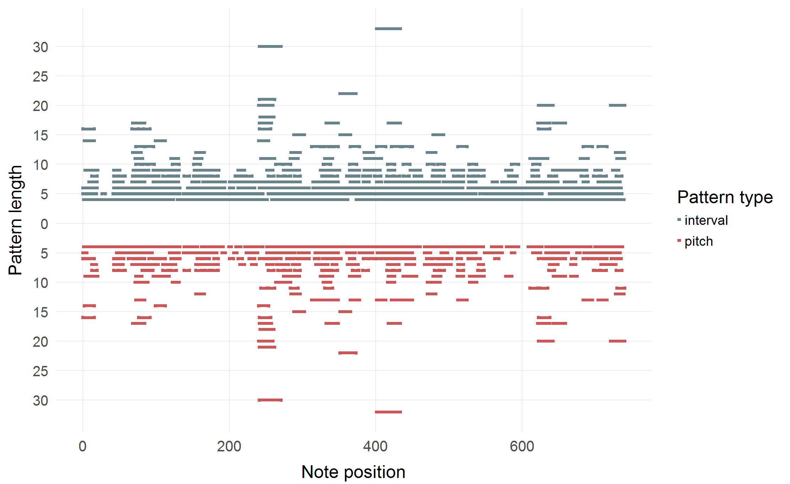
Example: Pattern partition (Charlie Parker, Koko)

Slide 39
Ideational Flow Model

Slide 40
Conclusion & Outlook

Slide 41
Conclusion
Computational, statistical and corpus-based methods offer interesting new possibilities for jazz research.
Quantitative approaches complement and enhance traditional, qualitative methods.
Computer-based analysis enables new investigations that are hard or impossible to accomplish without (e.g., intonation, patterns).

Slide 42
Outlook
Possibilities of computational musicology not yet exhausted.
Current project: Dig That Lick (2017—2019), focus on patterns, formulas, licks (in co-operation with jazz research and music informatics from London, Paris, New York, Urbana Champaign).
Analysing multitrack recordings (e.g., Montreux archive).
Polyphonic soli (piano), rhythm section.
Analysis-by-synthesis: Test of improvisation models by automatic generation of jazz soli.

Slide 43
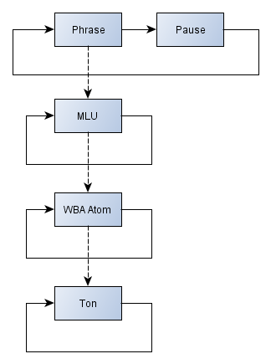
Outlook: A Grammar for Jazz Solos
WBA atoms:
Repeition
Diatonics
Chromatics
Arpeggos
Approaches
Trills
X-atoms

Slide 44

Outlook: Automated Solo Generation
Musical Turing Test:
Which solo is computer generated?

Slide 45
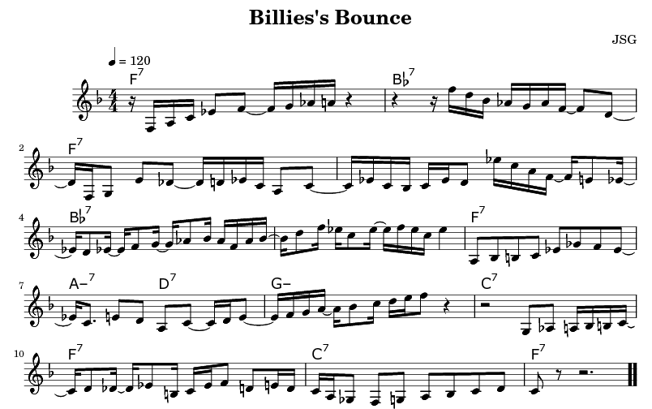
Outlook: Automated Solo Generation

Slide 46
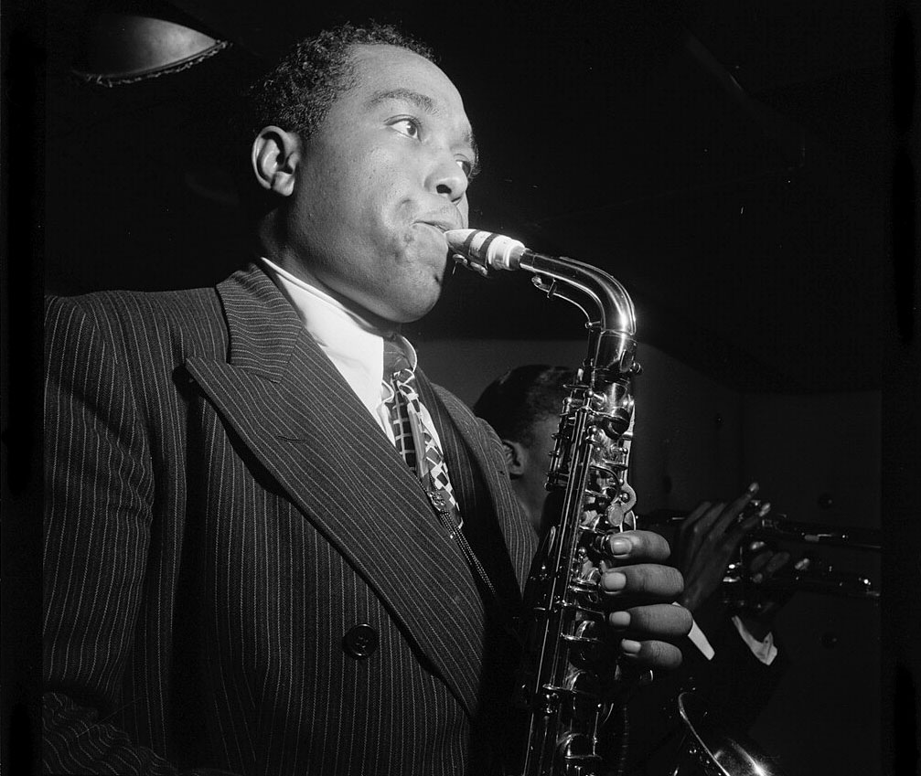
Thank
you!
Questions?
http://jazzomat.hfm-weimar.de/

Slide 47
Part III: Hands on

Slide 48
Hands-on
Tools:
Feature History Explorer
Pattern History Explorer
Dig That Lick Pattern Search
Dig That Lick Similarity Search
https://jazzomat.hfm-weimar.de/interactive.html

Slide 49
Feature History Explorer
Visualizes development of solo features in the WJD over time.
x-axis: recording year (or decade).
y-axis: selected feature.
Scatterplot with (polynomial) regression line.
Goodness-of-fit values: R², p value, AIC.
With or without aggregation.
Filtering, colouring, and presentations options.

